Slide 1
Computer Graphics Project Proposal
Jack Hosking 16932920

Slide 2

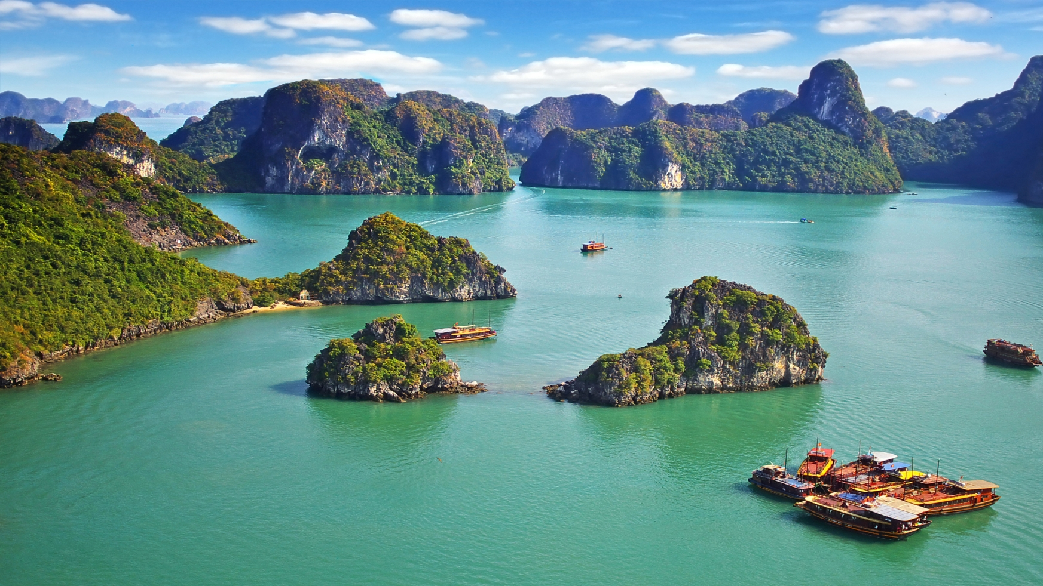
Project Theme
The environment will be island based, a sea level and a flying object to navigate through the scene.
Scale: 1 unit, is 1 meter.

Slide 3
Address core requirements
Animated spotlight at front of drone.
Texture mapping drone surfaces
Day and night cycles
Grid Ground
Following behind a drone object flying through environment
Tracking Camera (3rd person camera, following drone)
Fog used to imitate distance

Slide 4
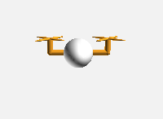

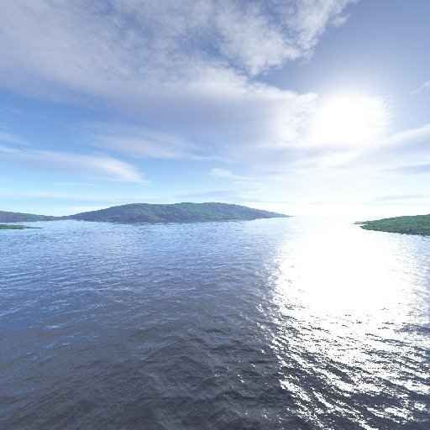
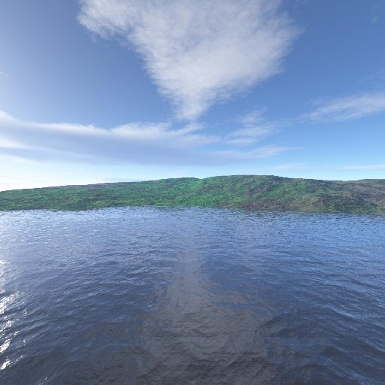
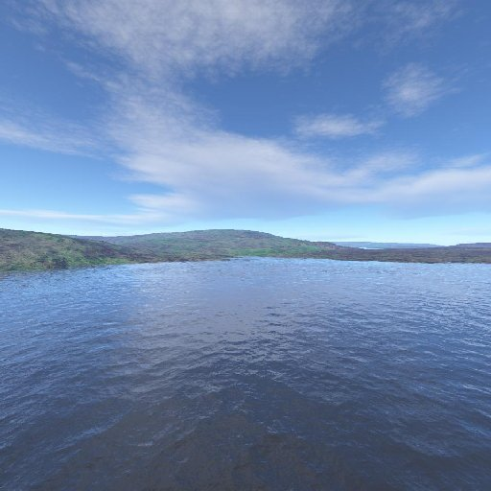
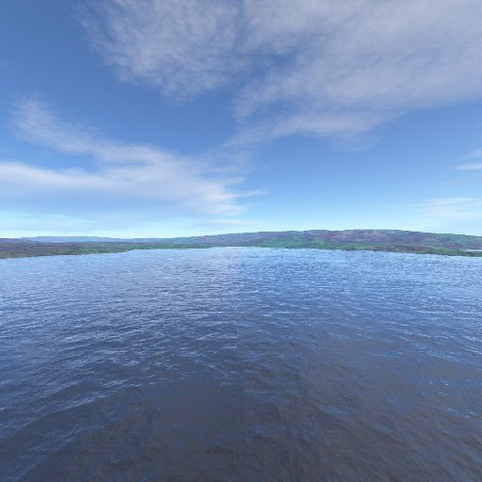
Supply details
Example Duelcopter
Dualcopter
implemented as hierarchical model
Spotlight at front
Used for flying around
Moving blades
Object camera will track and there will be a key controlled free camera (looking at the dualcopter, but able to track around any angle and height.
Fog used for day/light cycle to have bigger affect with light changes.
Terrain will be a height map image parsed to generate the terrain.
Possible skybox textures

Slide 5
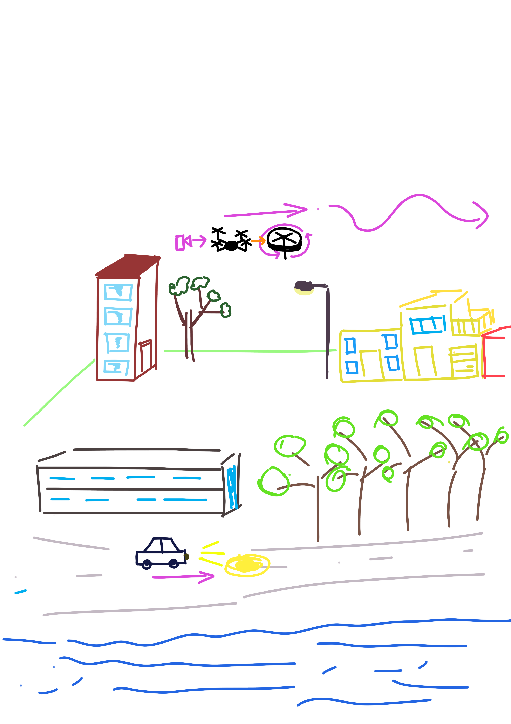

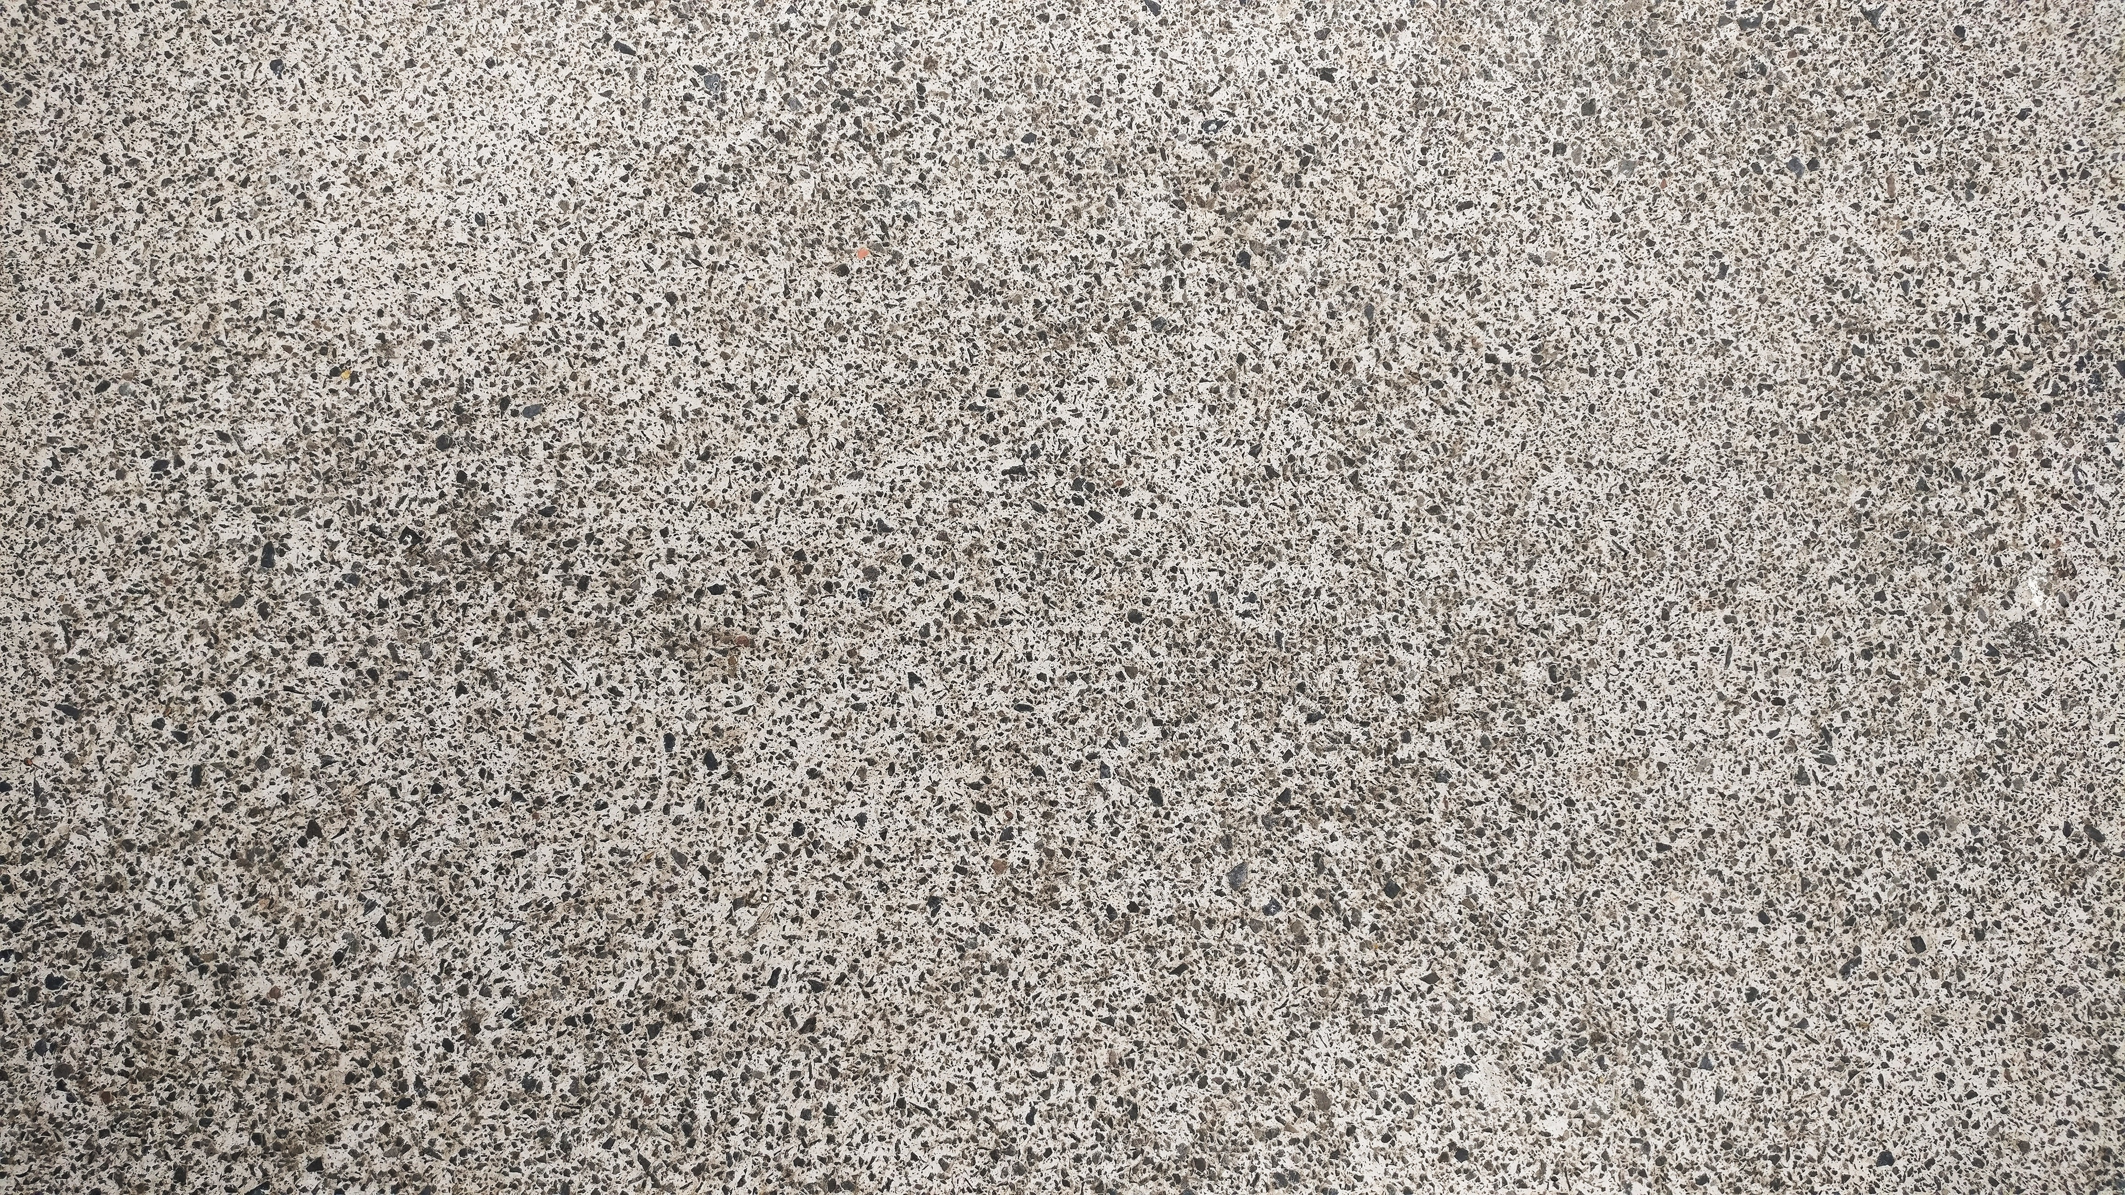
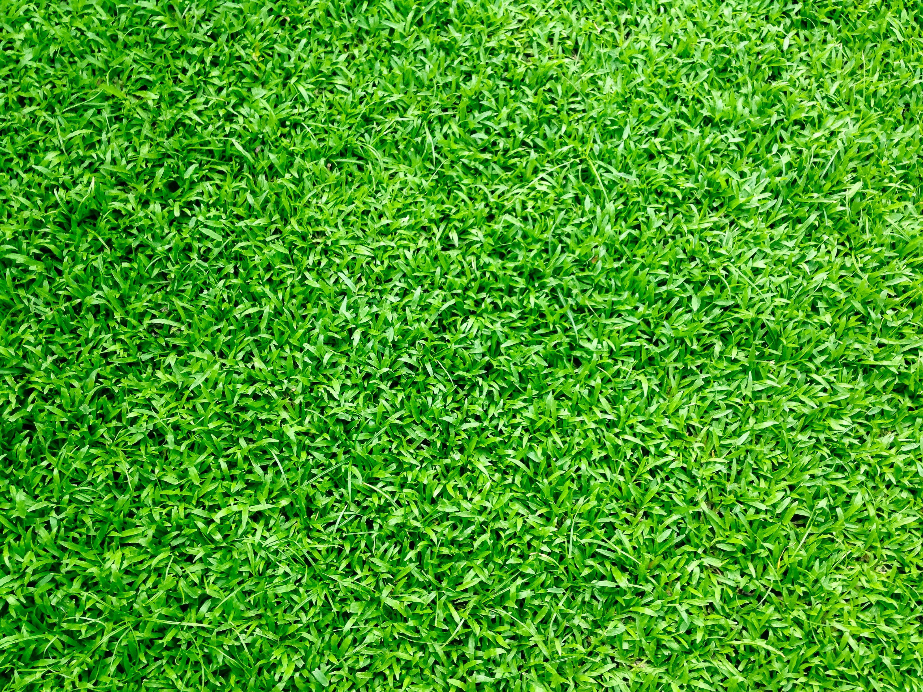
Example
Textures from https://www.pexels.com – CC0 License
free for personal and commercial use, no attribution required
Quadcopter
implemented as hierarchical model
Used for fly by – keyboard controls
Object camera will track and optional top down view (key controlled)
Buildings
Procedural mesh – in display list
Procedural mesh means whole side of building not light and can light it more realistically
Car, also hierarchical model, animated on fixed path, has 2 spotlights attached that light the road surface
Terrain is a flat gird of squares divided into regions, regions texture mapped differently (road, sea, grass). Water texture rendered with some transparency.
Fog – as scene at night dark fog used to enhance night time effect so not just lights
Trees – mesh model low res obj files with materials

Slide 6
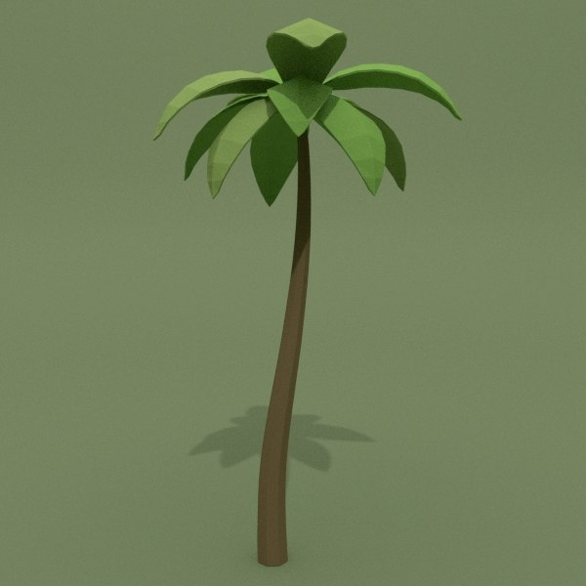
Obj file
Tropical palm by by Zerkalo_TMY from Carrot & Crystal 3D model
Low res
Royalty Free from www.turbosquid.com

